Slide 1



BUILDING
RECOMMENDATION
ENGINES
WITH SPRING

Slide 2


MICHAEL MINELLA
TWITTER: @MICHAELMINELLA
HOME PAGE: SPRING.IO/TEAM/MMINELLA

Slide 3


I STAND BETWEEN YOU AND
LUNCH

Slide 4


OFFICE HOURS
1:40 TODAY!

Slide 5


Slide 6

http://github.com/mminella/RecommendationEngine

Slide 7


Slide 8
11
14
7
12
20
16
5
17
6
3
2
8
18
13
4
1
10
19
23
15
9

Slide 9


Notes:
Look at the site we’ll update
Also look at the technologies we’ll use

Slide 10

RECOMMENDATION
ALGORITHMS

Slide 11

/**
* @author Michael Minella
*/
@Configuration
@ComponentScan
@EnableAutoConfiguration
public class Application {
@Bean
ItemBasedRecommender recommender(DataSource dataSource) {
DataModel dataModel = new MySQLBooleanPrefJDBCDataModel(dataSource);
ItemSimilarity similarity = new MySQLJDBCItemSimilarity(dataSource);
AllSimilarItemsCandidateItemsStrategy candidateItemsStrategy =
new AllSimilarItemsCandidateItemsStrategy(similarity);
return new GenericItemBasedRecommender(dataModel, similarity, candidateItemsStrategy, candidateItemsStrategy);
}
public static void main(String[] args) {
SpringApplication.run(Application.class, args);
}
}

Slide 13
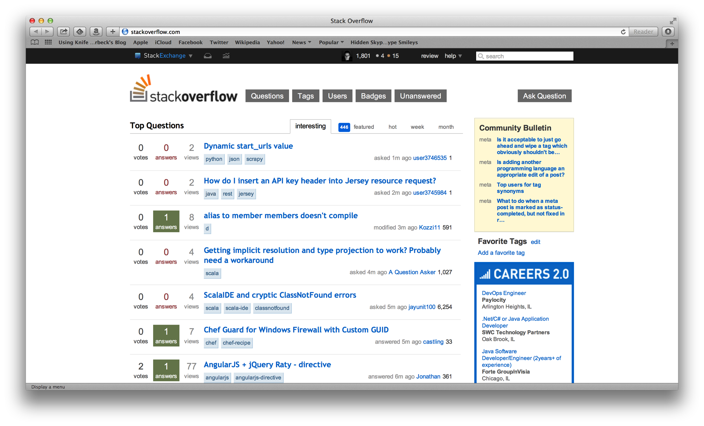

Slide 14
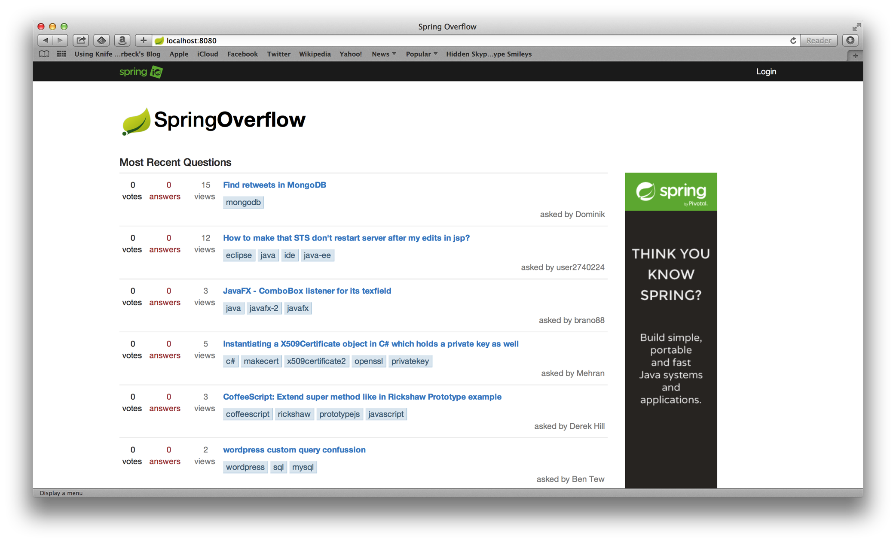

Slide 15
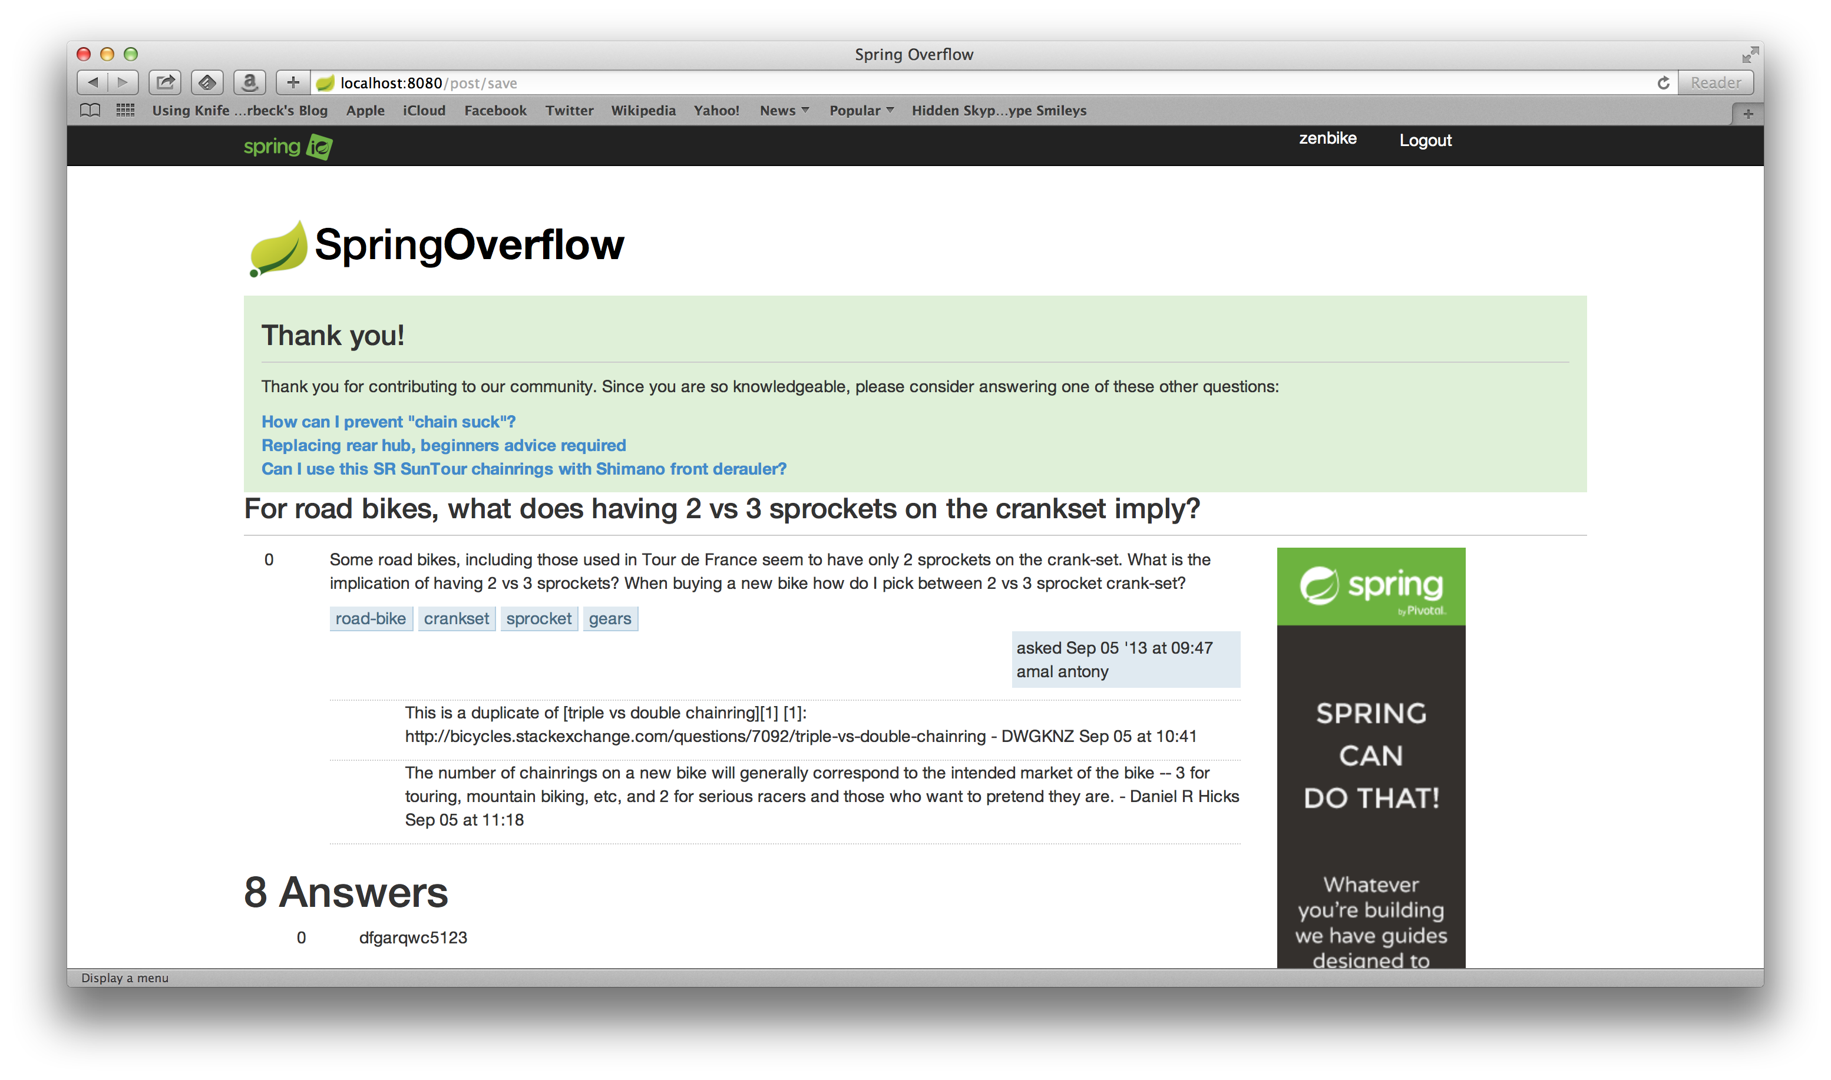

Slide 16
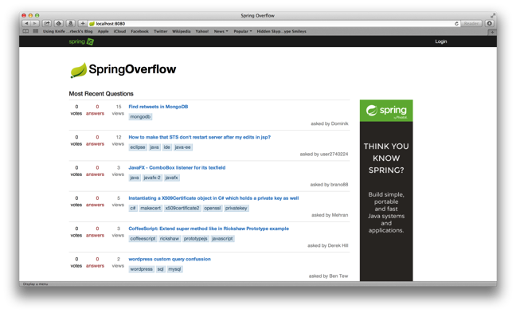



Notes:
Spring XD handles everything in the circle

Slide 17

TOOLS AND
TECHNOLOGIES

Slide 18
1
SPRING BOOT
Notes:
Spring Boot, Spring Data JPA, Spring Core/MVC, Spring Security,

Slide 19
2
MYSQL

Slide 20
3
HADOOP

Slide 21
4
SPRING XD

Slide 22
5
MAHOUT

Slide 23

SPRING XD
EXTREME DATA

Slide 24


APPLICATION
COMPLEXITY

Slide 25



LOTS OF
BOILERPLATE

Slide 26

MANY DOMAINS TO
BRIDGE

Slide 27






INCONSISTENT
APIS

Slide 28
SOURCE, CHANEL, SINK
DATA FLOW MODEL
=
ADAPTER, CHANEL, FILTER, TRANSFORMER, ETC
EIP PATTERNS

Slide 29
JOB, CONNECTOR
IMPORT/EXPORT
=
JOB, ITEMREADER/ITEMWRITER
BATCH PROCESSING

Slide 30
WORKFLOW, ACTION
WORKFLOW
ORCHESTRATION
=
JOB, STEP
BATCH PROCESSING

Slide 31
SPRING XD
EXTREME DATA

Slide 32

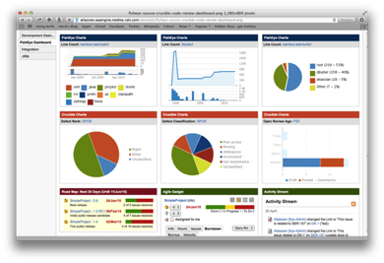





Ingestion
Orchestration
SPRING
Extraction
Real-time
Analytics
Notes:
Spring XD handles everything in the circle

Slide 33

DISTRIBUTED
RUNTIME

Slide 34
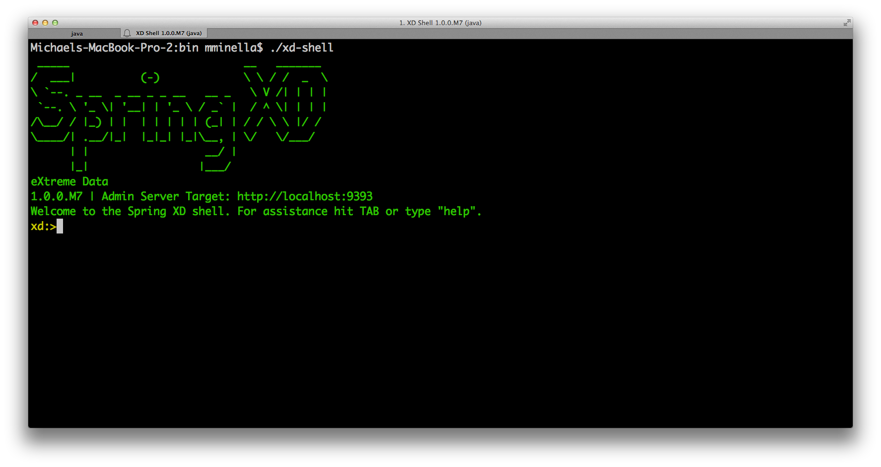

Slide 35
http
|
hdfs
--directory=/xd/dir1
--port=8181
filter --expression=“payload?.price > 3.00” |

Slide 36


Slide 37

TOTAL LINES OF CUSTOM CODE
47 Lines of Java
29 Lines of XML
6 Spring XD Shell Commands

Slide 38
RECOMMENDATION
ALGORITHMS

Slide 39

COLLABORATIVE
FILTERING

Slide 40

TWO OPTIONS

Slide 41

USER BASED
Notes:
Compare users. Determine what users exhibit the same patterns as the current user.

Slide 42




ITEM BASED
Notes:
Invented by Amazon (you bought X…you may be interested in Y)
Item Based scales better (a function of your catalog, not your customer base)
Item Based doesn’t need to be updated as frequently

Slide 43
PEOPLE ARE
FUNNY

Slide 44
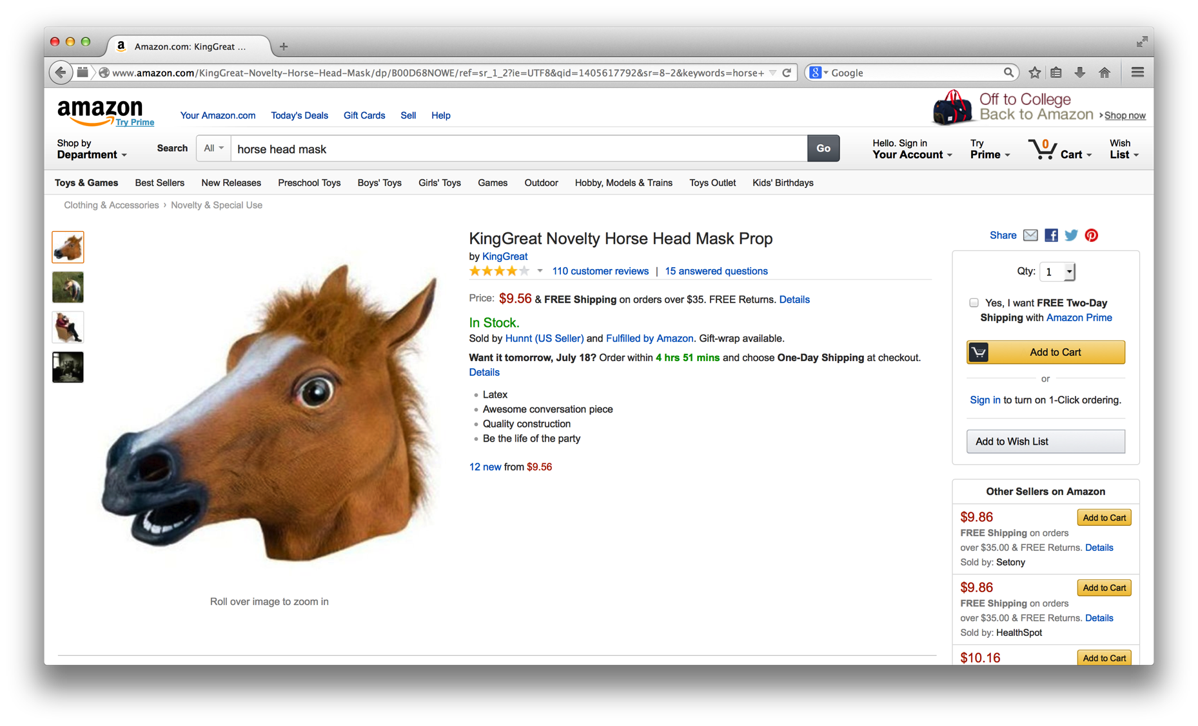

Slide 45
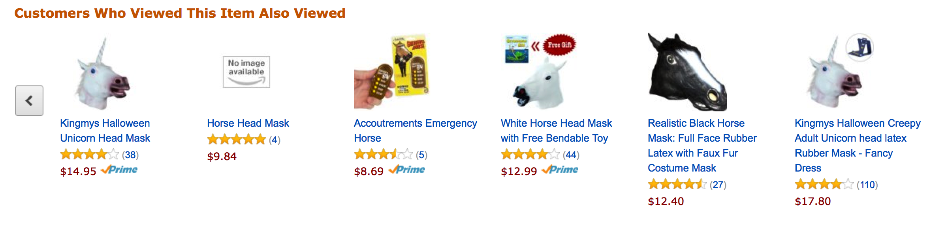
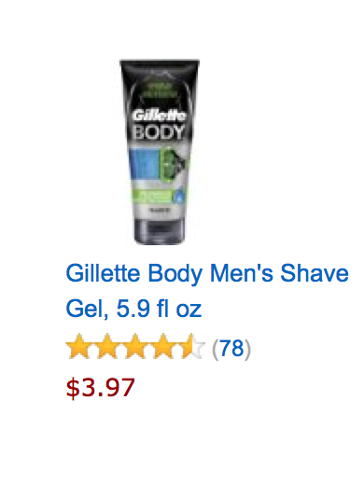
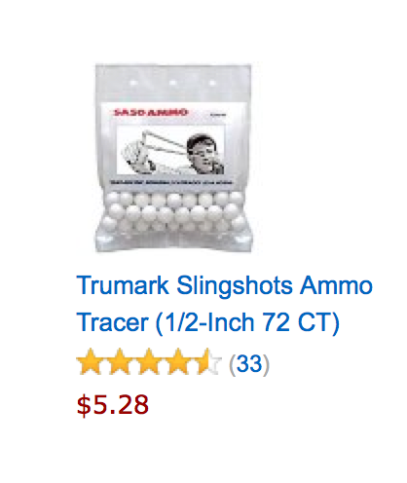

Slide 46
/**
* @author Michael Minella
*/
@Configuration
@ComponentScan
@EnableAutoConfiguration
public class Application {
@Bean
ItemBasedRecommender recommender(DataSource dataSource) {
DataModel dataModel = new MySQLBooleanPrefJDBCDataModel(dataSource);
ItemSimilarity similarity = new MySQLJDBCItemSimilarity(dataSource);
AllSimilarItemsCandidateItemsStrategy candidateItemsStrategy =
new AllSimilarItemsCandidateItemsStrategy(similarity);
return new GenericItemBasedRecommender(dataModel, similarity, candidateItemsStrategy, candidateItemsStrategy);
}
public static void main(String[] args) {
SpringApplication.run(Application.class, args);
}
}

Slide 47
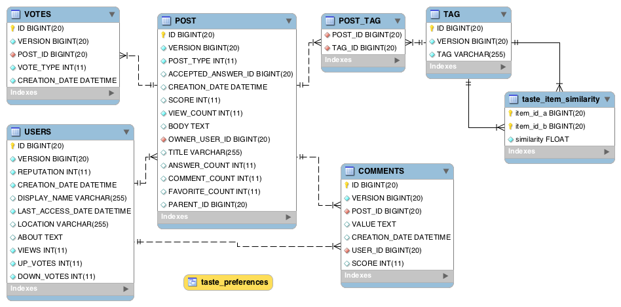

Slide 48
USER_ID, TAG_ID, VOTES
TAG_ID, TAG_ID, SCORE
Notes:
File in HDFS with following format:
userId, tagid, score
Results from Mahout job
tagId, tagId, score

Slide 50

The
End

Slide 51

Learn More. Stay Connected.
Twitter: twitter.com/springcentral
YouTube: spring.io/video
LinkedIn: spring.io/linkedin
Google Plus: spring.io/gplus
Spring Batch
Project: spring.io/spring-batch
Github: github.com/spring-projects/spring-batch
Jira: jira.spring.io/browse/BATCH
Spring Boot
Project: spring.io/spring-boot
Github: github.com/spring-projects/spring-boot
Spring XD
Project: spring.io/spring-xd
Github: github.com/spring-projects/spring-xd
Jira: jira.spring.io/browse/XD

Slide 52














Check Box by Hrag Chanchanian
from The Noun Project
Question by Jessica Lock
from The Noun Project
Servers by Jaime Carrion
from The Noun Project
Crane by Kenneth Von Alt
from The Noun Project
Nut by Naomi Atkinson
from The Noun Project
Funnel by Volodin Anton
from The Noun Project
Circuit by Piotrek Chuchla
from The Noun Project
Puzzle by Matthew Hall
from The Noun Project
Network by Mister Pixel
from The Noun Project
Puzzle by Eric M. Ellis
from The Noun Project
People by Wilson Joseph
from The Noun Project
Database by Anton Outkine
from The Noun Project
Fork by Dmitry Baranovskiy
from The Noun Project
Maze by Gilbert Bages
from The Noun Project

